Slide 1
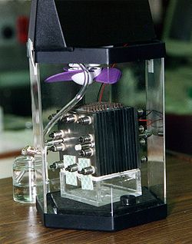
FUEL CELLS

Slide 2
Introduction – Fuel Cells
Chemical Energy → Electrical
Consists of +ve & -ve electrodes with electrolyte in b/w
1st Fuel Cell (1839) – William Grove (England)
1st application in spacecraft as source of power & water

Slide 3
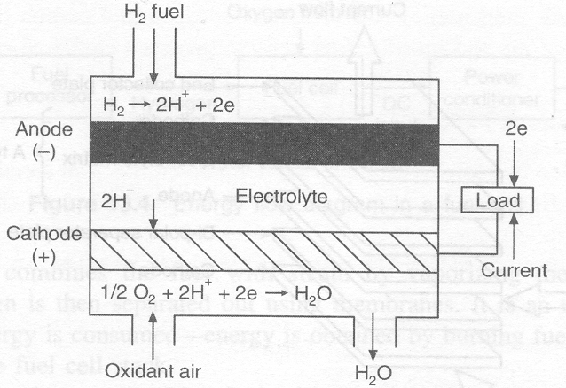

Operating Principle
Reverse process of electrolysis
2H₂ + O₂
2 H₂O
+ Electric Energy
+ Heat Energy
Fuel Cell Operation

Slide 4
Technical Parameters
An individual cell ~ 0.55 to 0.75 V
Current density ~ 100 to 500 mA/cm²
For any power rating, appropriate electrode area & required no. of cells are selected

Slide 5
Merits
Eco-friendly, Noiseless, No rotating components
Power production in de-centralised manner
High Efficiency ( 55%)
Modular nature
Wide choice of fuels (Natural gas, Methanol, LPG, Biogas – All rich in H₂)
Can supply hot water & steam
Demerits
High initial cost
Low service life

Slide 6
Fuel Cell Types
Based on the electrolyte used
Alkaline FC’s ( AFC)
Proton Exchange Membrane FC’s (PEMFC)
Phosphoric Acid FC’s ( PAFC)
Molten Carbonate FC’s ( MCFC)
Solid Oxide FC’s(SOFC)

Slide 7
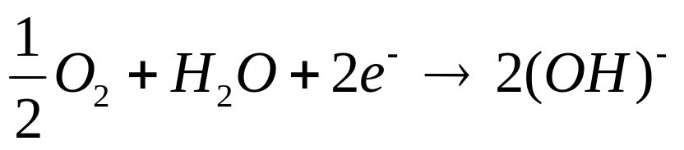
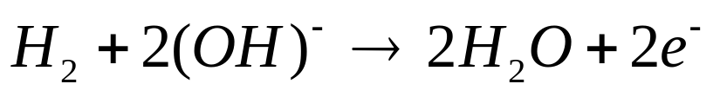
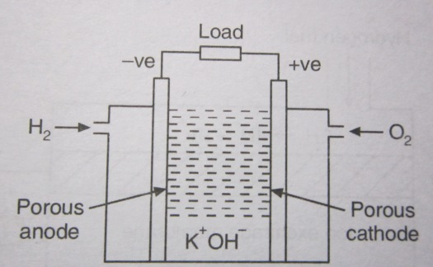
Alkaline Fuel Cells
Electrolyte – KOH, Electrodes – Nickel
At cathode (K):
At anode (A):
Temp ~ 80ºC
η ~ 70 %

Slide 8
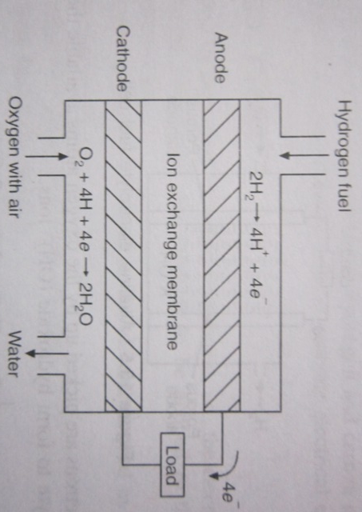
Proton Exchange Membrane Fuel Cells (PEMFC)
Solid electrolyte acts as Ion exchange membrane
Fuel is H₂ with air as oxidant
Membrane is impermeable to gases but allows H ions to cross
η > 60 %
Temp. < 100ºC

Slide 9
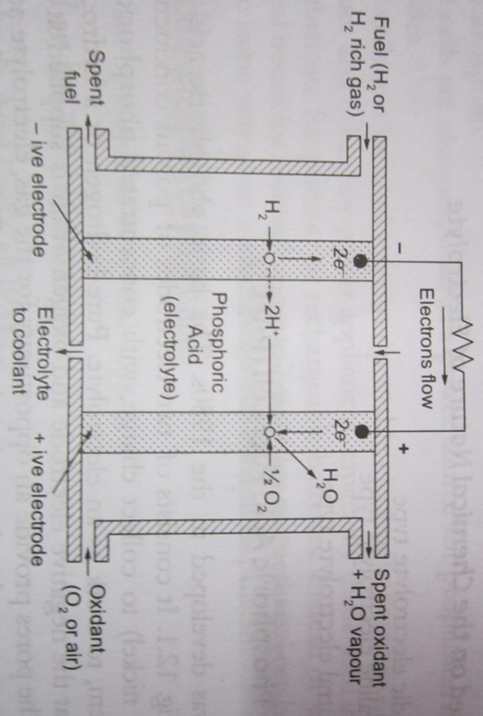
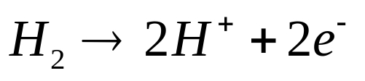
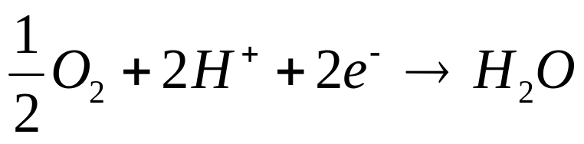

Phosphoric Acid Fuel Cell
Electrolyte matrix – Concentrated Phosphoric acid
A→ Porous graphite, K→ Porous graphite with Platinum as catalyst
Temp < 200ºC

Slide 10
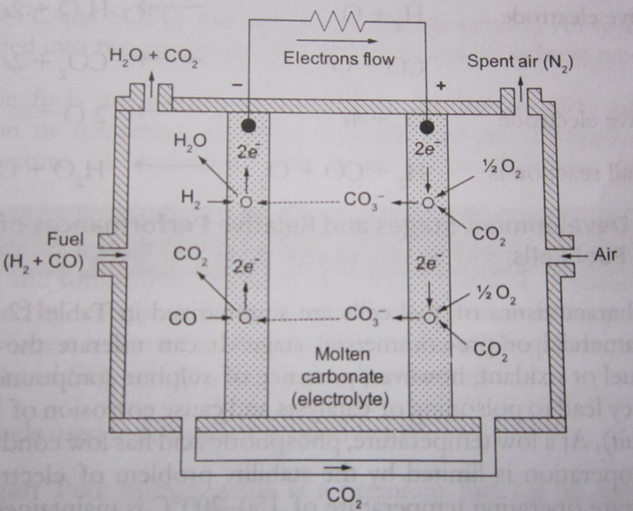
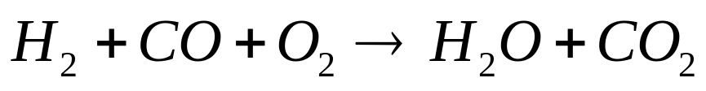
Molten Carbonate Fuel Cells ( MCFC)
Electrolyte: Molten mixture of alkali carbonates
Electrodes: Porous nickel /Nickel Oxide
Operating temp. of 650ºC keeps electrolyte in liquid phase
Fuel gas from fossil
fuels contains CO
A
K
Overall Reaction

Slide 11
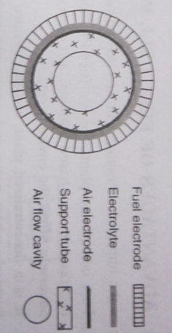
Solid Oxide Fuel Cells
Electrolyte: Solid metal oxide electrolyte (Zirconium dioxide)
A→ Porous Nickel, K→ Indium Oxide
Operates at ~1000ºC
Fuel contains H₂ + CO
Overall Reaction

Slide 12
Operating Characteristics
Actual voltage (V) across a fuel cell when a load is connected < Open circuit voltage (Vo)
Diff. b/w actual & open circuit voltage is known as polarization (Vp = Vo – V )
Polarization reduces η of fuel cell

Slide 13
Operating Characteristics
Due to chemical polarization
Due to resistance polarization
Due to electrolyte concentration polarization
Open Circuit Voltage, Vo
Vp
Actual Cell Voltage, V
Current Density, I_{D}

Slide 14
Chemical Polarization
At low I_{D}, less no. of e⁻ are emitted
To increase the current, energy is supplied by the fuel cell
This causes a drop in voltage
This effect can be reduced by using a electrode catalyst or by operating at high temperature

Slide 15
Internal Resistance Polarization
Due to the internal resistance faced to the flow of ions
Sum of electrode, electrolyte & contact resistances b/w electrode & electrolyte
Can be reduced by
Decreasing the electrode size
Coating electrodes with good conductor
Increasing the electrolyte concentration
Reducing distance b/w electrodes

Slide 16
Electrolyte Concentration Polarization
Caused due to concentration loss of the electrolyte near the electrode
Results in slow ionic movement
Can be reduced by stirring the electrolyte

Slide 17

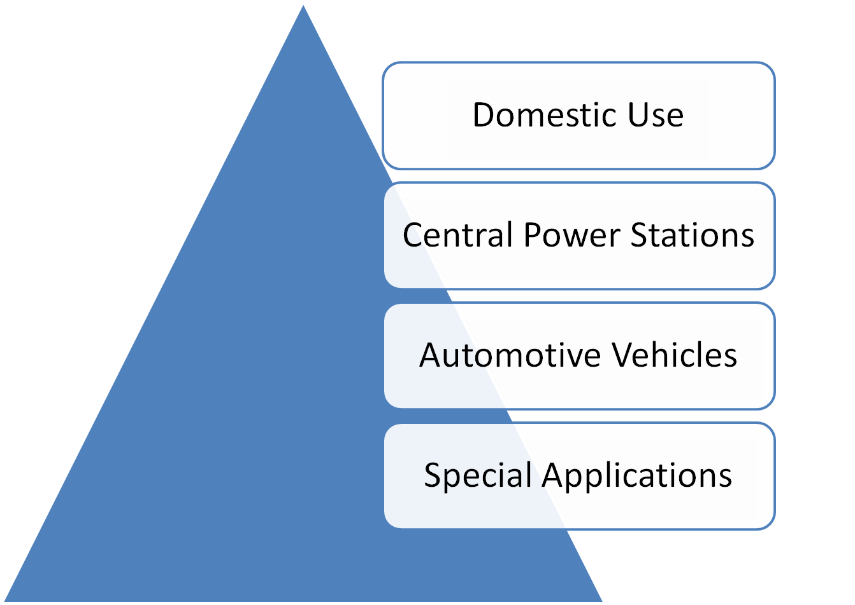

Slide 18
For Domestic Use
No. of cells connected in series/parallel – produce reasonable voltage and current
Can supply power for lamps or electric loads
- Either as DC or as AC by using an inverter
In Central Power Stations
Can produce electricity on large scale
Can be installed near to the end user

Slide 19
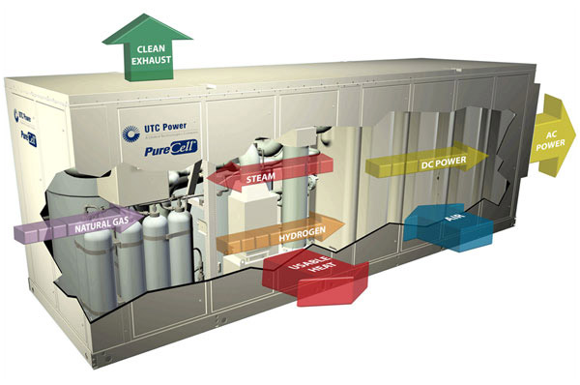
A 400 kW Fuel Cell Power Plant

Slide 20
In Automotive Vehicles
Can be used as a source of power in electric vehicles
Pollution free automobiles
H₂ to be stored in the vehicle
In Special Applications
As source of power in Military and Space applications

